Slide 1
Code as Policies: Language Model Programs for Embodied Control
Ila Ananta (24956) and Siddharth Jain (24365)
04/29/2025

Slide 2
Agenda
Introduction
Literature Survey
Overview of the base paper
Our Proposed Approach and extension
Results
Conclusion and Future Scope

Slide 3
Introduction
Recent advances in Large Language Models (LLMs) enable robots to interpret and execute natural language commands.
Traditional approaches (semantic parsers, symbolic planners, end-to-end learning) require heavy engineering and struggle with generalization.
Code as Policies (CaP) proposes a new paradigm:
Use LLMs to directly generate executable robot code from language prompts.
Apply few-shot prompting with example instruction-code pairs.
Generated code:
Integrates perception outputs (e.g., object detections) with control APIs.
Utilizes logic structures, feedback loops, and spatial reasoning libraries.
Hierarchical code generation enables recursive function creation and multi-step behavior synthesis.
Benefits:
Generalizes to novel instructions without retraining.
Provides interpretable, modular robot policies.

Slide 4


Slide 5

CLOSED LOOP FEEDBACK

Slide 6
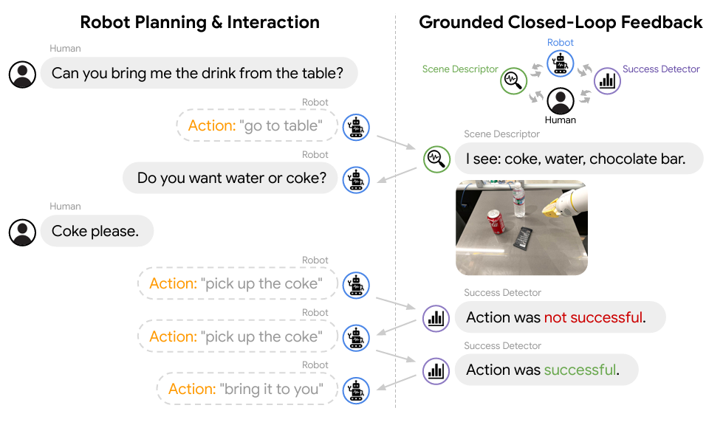
Inner Monologue: Enhancing LLM-Based Robotics with Closed-Loop Feedback
Introduces a closed-loop framework for integrating real-time feedback into LLM-based robotics planning, overcoming the limitations of open-loop execution.
e.g. “I have to unlock the door; let me try to pick up the key and put it in the lock... no, wait, it doesn’t fit, I’ll try another one... that one worked, now I can turn the key.”
- Core Concept:
Inspired by the human cognitive process of "inner
monologue", the robot continuously reflects on actions and
adapts based on feedback.
Feedback, such as success detectors, scene descriptions,
and human inputs, is fed back into the LLM’s decision-making
process.
- System Architecture:
Iterative decision-making: After each action, feedback is
converted to natural language and used to adjust the next step.
Key Features:
Allows robots to recover from failures, adapt to changing instructions, and interactively query humans for clarification when faced with ambiguity.
Huang, Wenlong, et al. "Inner monologue: Embodied reasoning through planning with language models." arXiv preprint arXiv:2207.05608 (2022).

Slide 7

Emulator

Slide 8
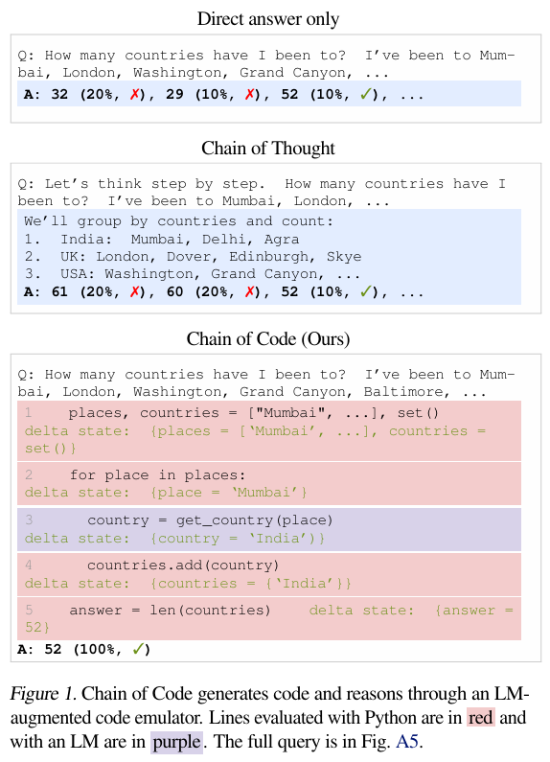
Chain of Code: Reasoning with a Language Model-Augmented Code Emulator
- Problem:
Code as Policies (CaP) showed LLMs can generate executable robot policies.
However, CaP struggles when reasoning involves both algorithmic (numeric, logical) and semantic (commonsense, linguistic) components, especially if necessary APIs or functions don't exist.
- Key Innovation:
Introduces LMulator — a system that detects when generated code cannot be executed (e.g., undefined functions).
Instead of stopping, the LLM simulates the expected output based on context and prior knowledge, allowing reasoning to continue.
- System Overview:
Code Generation: LLM writes structured code or pseudocode, combining executable steps and semantic queries. Code Execution with LMulator: Python interpreter executes normal code.
LMulator "emulates" outputs for undefined or semantic functions, updating program state. Interleaves real execution and simulated inference until task completion.
Li, Chengshu, et al. "Chain of code: Reasoning with a language model-augmented code emulator." arXiv preprint arXiv:2312.04474 (2023).

Slide 9

Reward Design

Slide 10
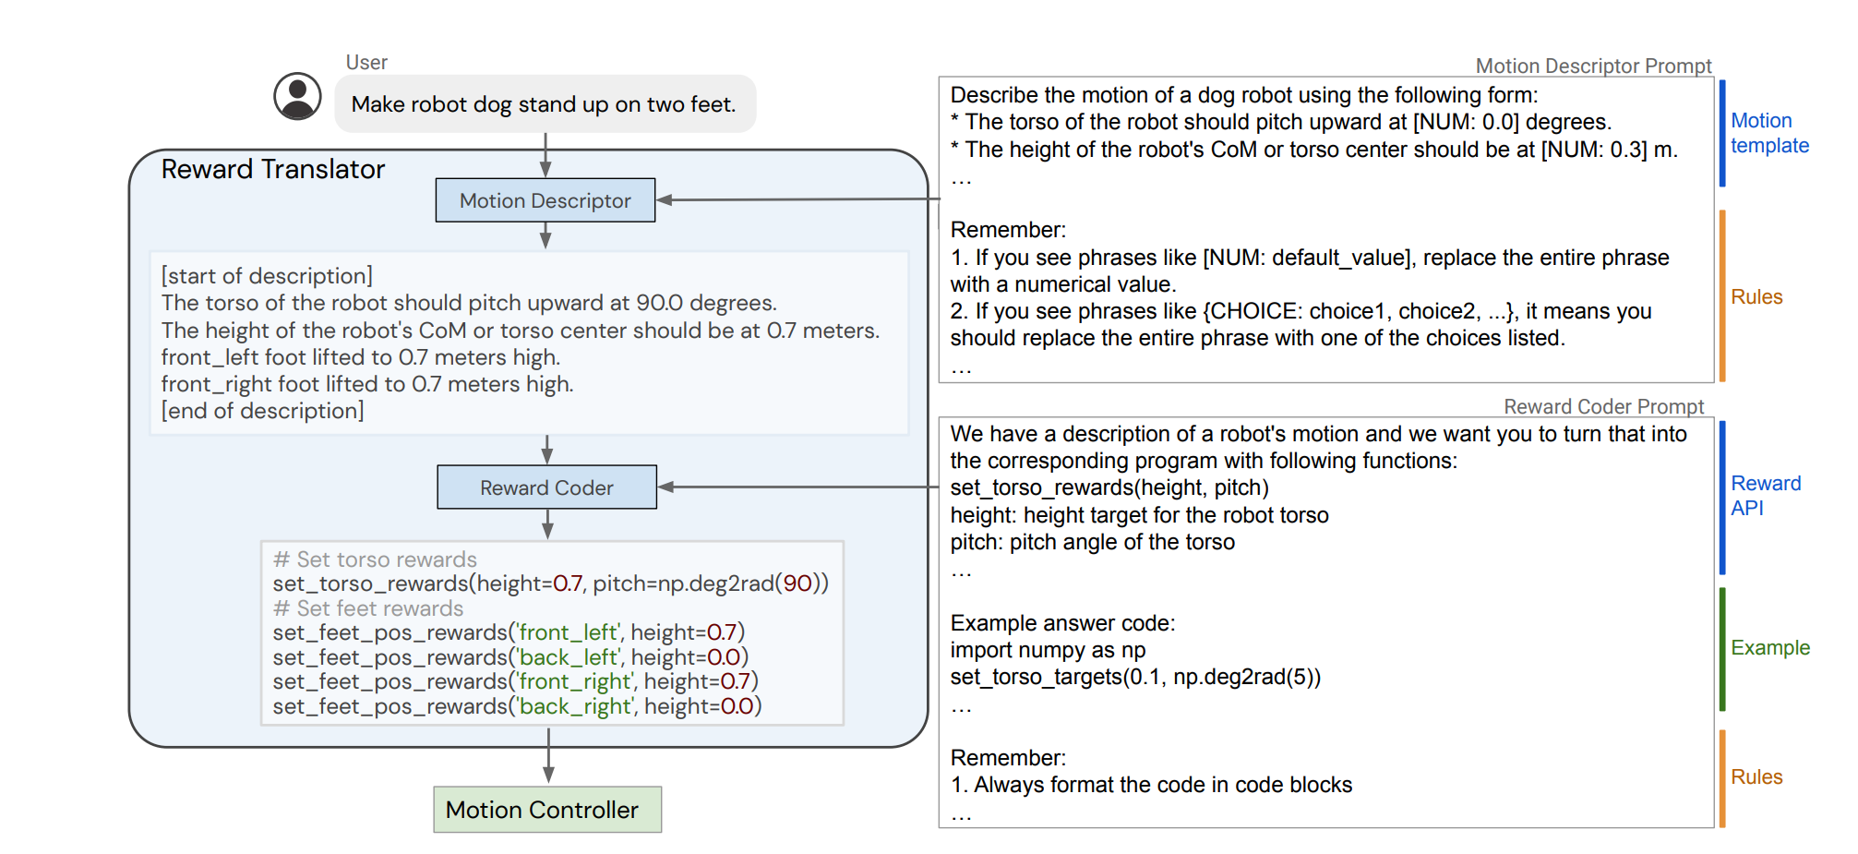
Language to Rewards for Robotic Skill Synthesis
Introduces a new method where LLMs define reward functions for robots to optimize.
Instead of sequencing actions, robots maximize rewards defined by LLMs.
Key Components:
LLM (like GPT-4) converts user instructions into reward parameters by generating code for predefined reward APIs
Optimization techniques (e.g., MuJoCo MPC) help the robot find the best actions to maximize rewards.
Process
Motion Descriptor LLM interprets task in plain language.
Reward Coder LLM converts this into code for reward generation.
Yu, Wenhao, et al. "Language to rewards for robotic skill synthesis." arXiv preprint arXiv:2306.08647 (2023).

Slide 11
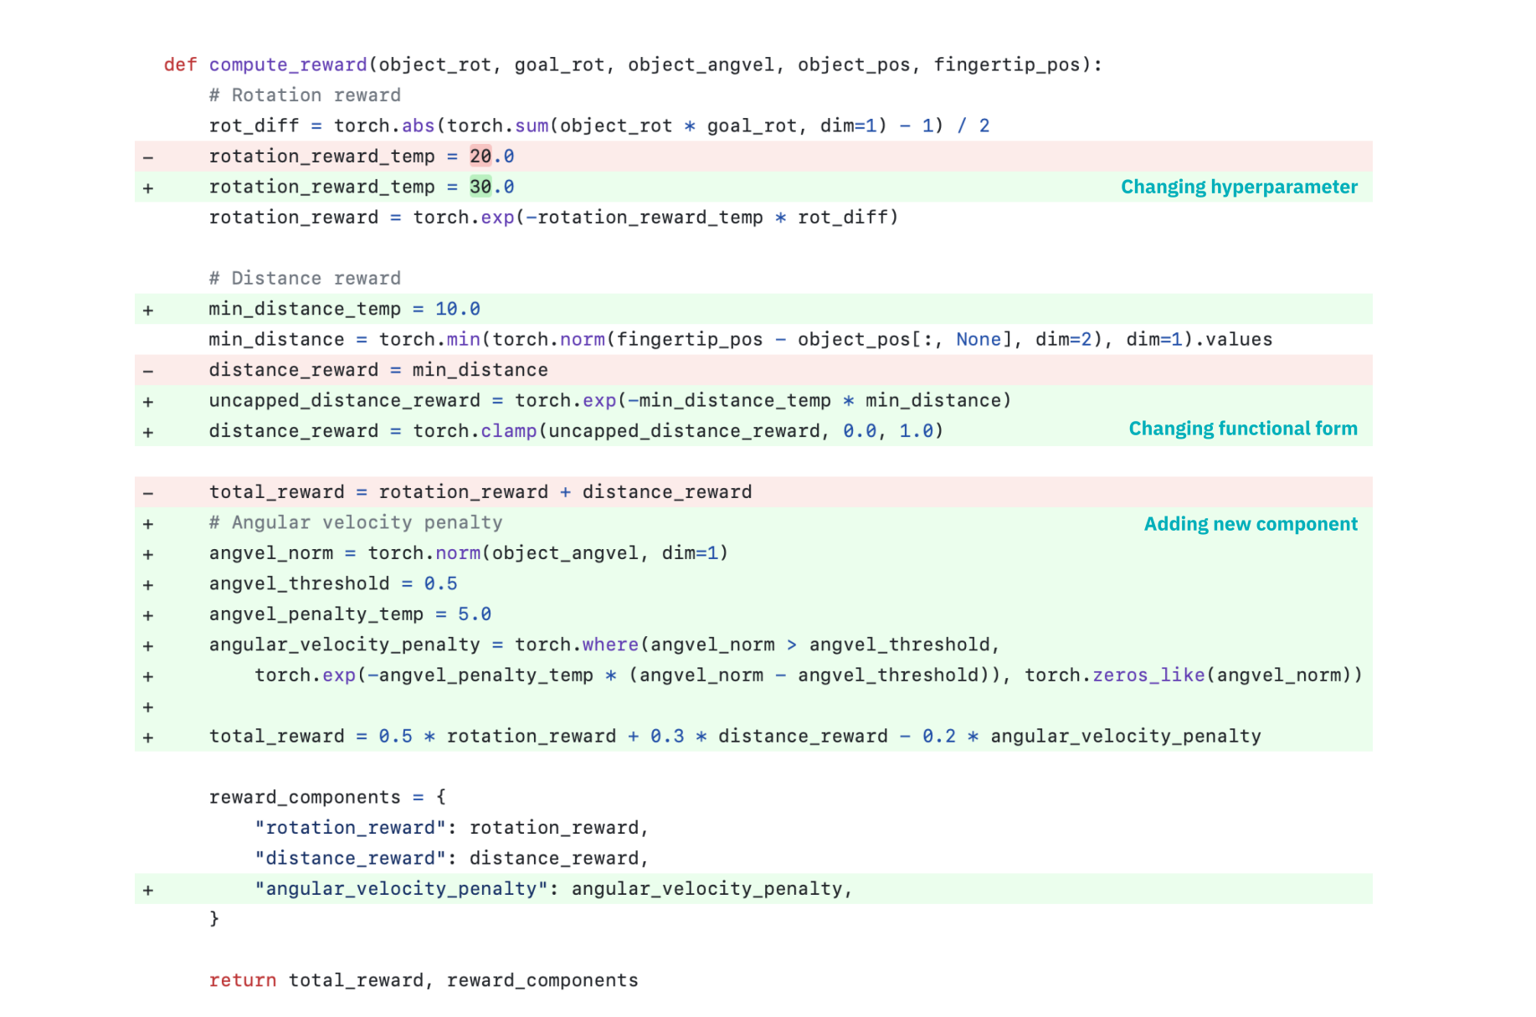
Eureka: Human-level reward design via coding large language models
EUREKA improves the generation of reward functions using LLMs.
Removes the need for manual templates and predefined reward APIs.
Key Components:
LLM receives robot environment code and generates reward functions directly.
Samples, evaluates, and improves reward candidates through iteratio
Performance:
Outperformed human-generated rewards in 83% of cases across 29 tasks.
Average performance improvement of 52%
Limitations
Primarily tested in simulation; real-world transfer still needs validation.
Ma, Yecheng Jason, et al. "Eureka: Human-level reward design via coding large language models." arXiv preprint arXiv:2310.12931 (2023).

Slide 12
Proposed Idea in the base paper:
Code as Policies (CaP) reimagines robots using LLMs (Large Language Models) not just to generate answers, but to synthesize executable policy code from natural language commands.
Robots receive natural language → LLM writes Python policy code → Code controls perception, planning, and control APIs.
Language Model Programs (LMPs): LLM generates modular Python code, calling perception APIs (e.g., object detection) and control APIs (e.g., move, pick).
Hierarchical Code Generation:
If undefined functions appear, the LLM recursively defines them.
Allows building complex, multi-step behaviors.
Understand commands like "put the block left of the bowl" using geometry libraries (e.g., NumPy, Shapely).
Generalization to New Instructions: No retraining needed; simply give new commands.
Higher success rates than baselines like CLIPort and traditional language planners, especially:
In unseen attributes or novel instructions settings.
For long-horizon and spatial-geometric tasks.
Liang, Jacky, et al. "Code as policies: Language model programs for embodied control." 2023 IEEE International Conference on Robotics and Automation (ICRA). IEEE, 2023.

Slide 13
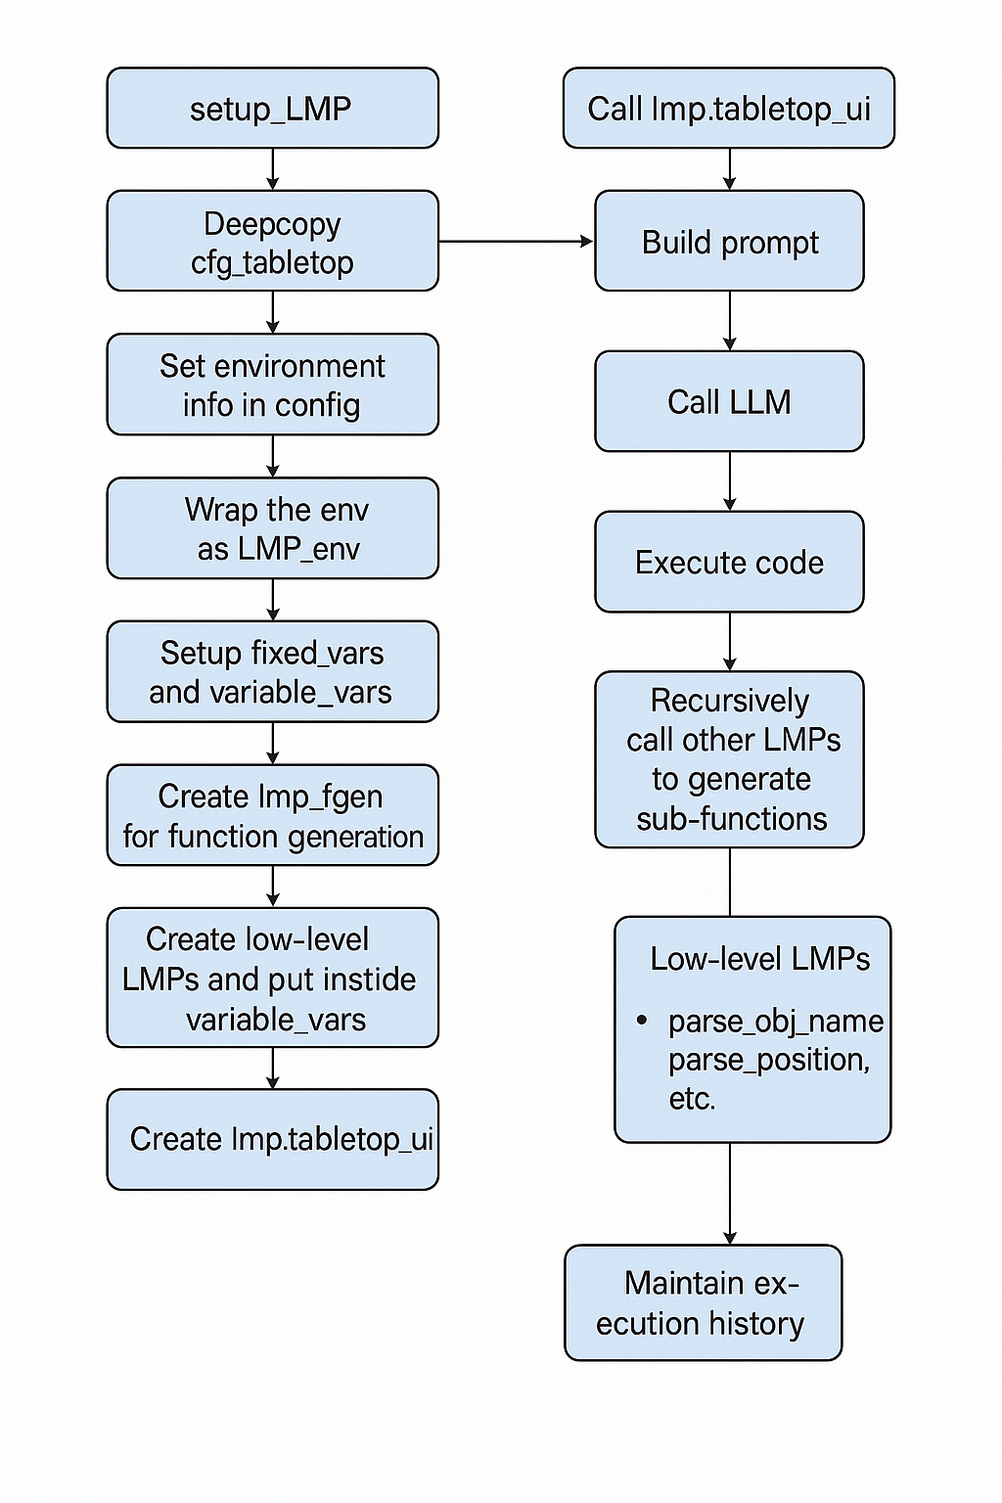
Flow Chart:

Slide 14

Proposed Extension

Slide 15
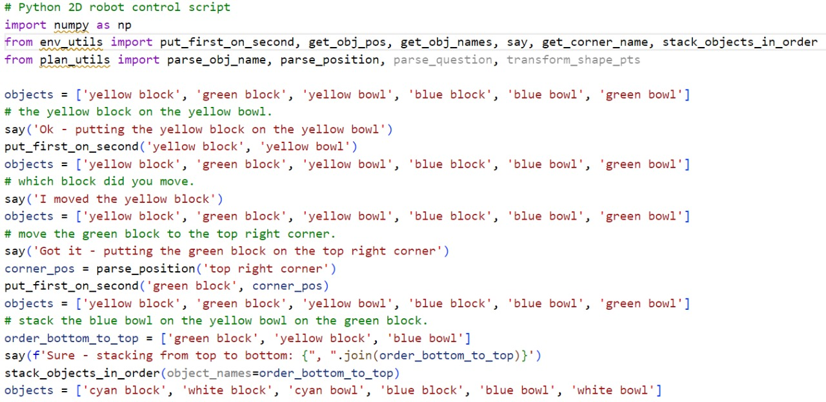
Initial Experiments with CodeLLaMA
Objective: Test if an open-source code model (CodeLLaMA) could replicate Code as Policies behavior with similar prompts.
CodeLLaMA often failed to produce meaningful code:
Generated irrelevant or generic code snippets.
Repeated few-shot examples verbatim without adapting to the new task.
Sometimes hallucinated completely unrelated outputs.
Weaker models struggled with:
Few-shot generalization.
Logical task reasoning.
Maintaining context coherence.
Key Insight:
Model capability matters as much as prompting: Simply reusing prompts on weaker models is insufficient without strong few-shot reasoning.

Slide 16
Transition to GPT-4 and Advanced Prompt Engineering
Switch to GPT-4:
Recognized that better reasoning and generalization was needed.
Transitioned to GPT-4 (specifically GPT-4o-mini), offering:
Stronger few-shot learning.
Better structured code output.
Deeper spatial and logical task understanding.
Prompt Engineering Improvements:
Explicit Output Constraints:
Instructed the model: "Only output code", "No explanations or extra text".
Ensured clean, immediately executable Python outputs.
Prompt Pruning and Quality Control:
Selected only the most representative, high-quality examples.
Avoided confusing the model with too many or too simple samples
Impact of Improvements:
GPT-4 could generate modular, reusable plans even for novel instructions not seen in the prompt.
Synthesized logical intermediate steps where necessary.
Achieved performance comparable to or exceeding the original Code as Policies results.

Slide 17
Results – Code Generation Examples with GPT-4o

Slide 18
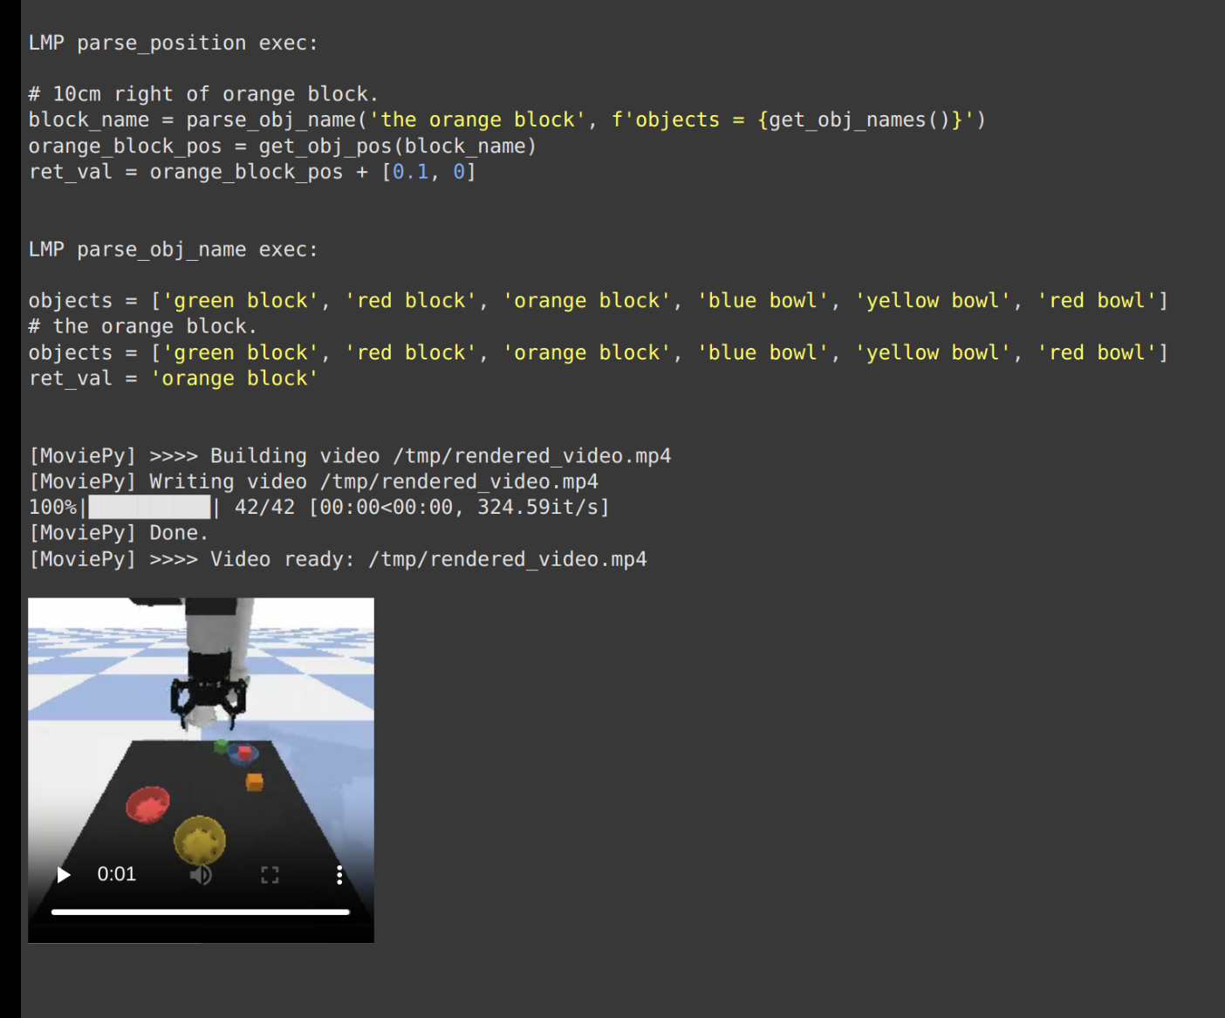
Task 1: "Move the orange block by 10 cm"
Model parsed object name and location correctly.
Generated structured code that computed displacement and executed precise move operations.
Organized functions modularly (e.g., parse_position, parse_obj_name).

Slide 19
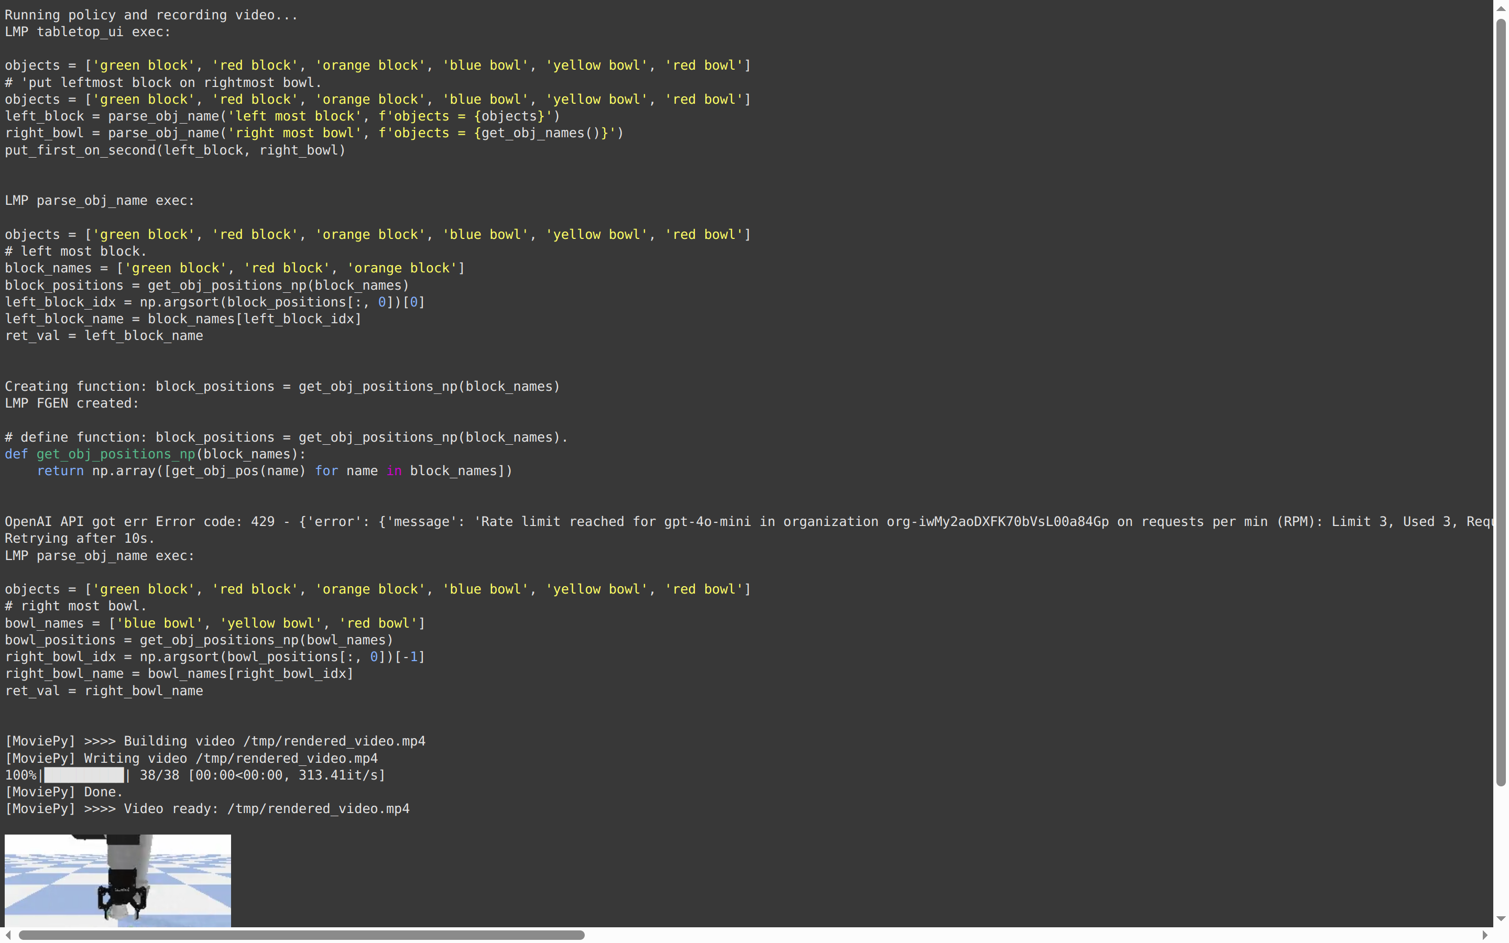
Task 2: "Put the leftmost block on the rightmost bowl"
Understood and computed spatial relationships.
Identified "leftmost" and "rightmost" entities through sorting logic.
Sequenced pick-and-place actions correctly with helper functions.

Slide 20
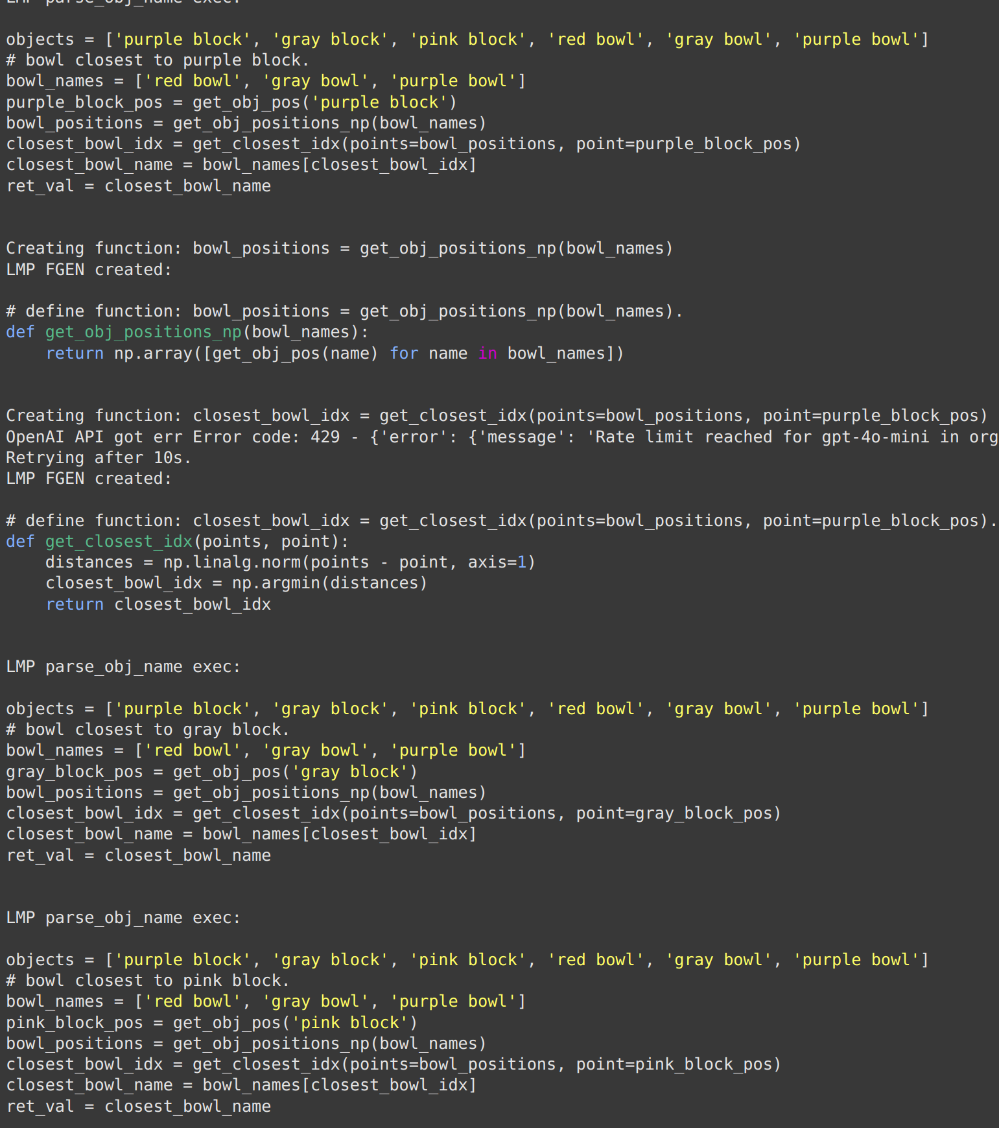
Task 3: "Put all bowls into the block closest to them"
The model correctly matched each bowl to the nearest block by checking distances.
The model was able to correctly identify the necessary operations and organize them into a series of recursive calls to low-level motion primitives (LMPs).
The code showed that the model could break down the instruction into smaller steps and organize the actions properly, not just copy patterns.

Slide 21
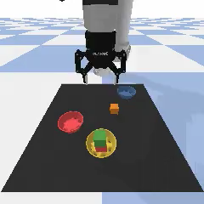
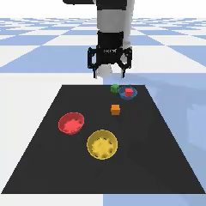
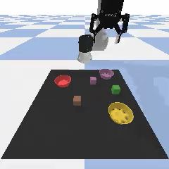
Videos generated for different commands
Put the leftmost block on the rightmost bowl
Move the orange block by 10 cm
Make triangle with the blocks only and no bowls

Slide 22
Conclusion and future work
Built upon the Code as Policies idea by using GPT-4o to generate robot control code from natural language, improving over GPT-3.
Showed that careful prompt refinement helps GPT-4o create more modular, reusable, and recursive code for both simple and complex tasks
Demonstrated GPT-4o’s ability to handle multi-step reasoning and organize actions through function calls and structured planning.
Further refine prompts to handle more complex, multi-layered instructions and push GPT-4o’s reasoning capabilities.
Explore fine-tuning the model specifically on robotic control data to boost accuracy and task adaptation.
Study how richer perception and dynamic feedback loops can enable even more generalizable robot behavior planning.
Evaluate the generated benchmark in the base paper on newer models like GPT-4.

Slide 23

THANK YOU!

